Slide 1


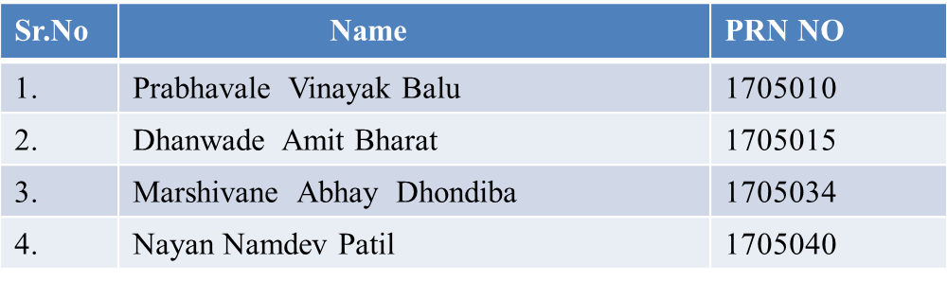
RIT-ETC
K. E. Society’s
Rajarambapu Institute of Technology, Sakharale
(An Autonomous Institute Affiliated to Shivaji University, Kolhapur)
B. Tech.
Electronics and Telecommunication Engineering
PROJECT ON
Design and Development of Authentication of Voting System.
UNDER THE GUIDANCE OF
Dr. M.S. Kumbhar

Slide 2
Topics
RIT-ETC
Introduction
Project Objectives and Project Motivation.
Block diagram
Proposed work
Methodology
Project Applications (Technical, Economical, Social)
Hw/Sw Requirements
Conclusion

Slide 3
Introduction
RIT-ETC
Voting is one of the way where you can express your opinion in democracy.
It gives the opportunity to choose their leader and hold them accountable for their development.
By using this project we want this above objective to taken into consideration.
Current voting system is based on ballot machine where when we press the button with the symbol the voting is done. Here there is a security risk, the person who votes may be a fake person. The people there might

Slide 4

Project Objectives
RIT-ETC
Project Objectives :
To Detect an Illegal Vote and make the election in more digitally controllable with accurate information for better future.
Face recognition also refers to the psychological process by which humans locate and attend to faces in a visual scene
We will try to reduce the election commission officers which are included in process of voting .
Cost can be reduced of entire process .
Objectives

Slide 5
Project Motivation
RIT-ETC
Project Motivation:
Fake voting .
More people work is required.
Here there is a security risk, the person who votes may be a fake person .
The proposed system is highly secure and no chances of data lost and also unlimited number of candidate information is being stored.

Slide 6
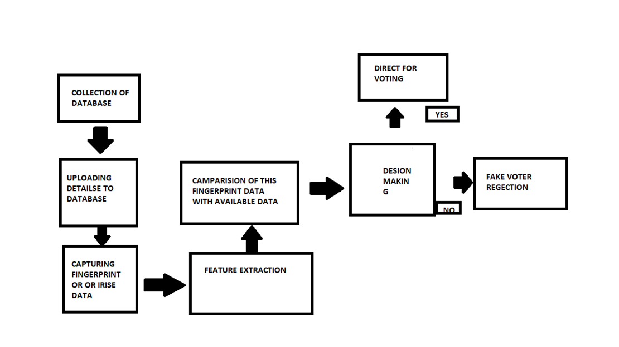
Block diagram
RIT-ETC

Slide 7
Proposed work
RIT-ETC
Finger print and Detection and Recognition system is proposed and it is used an authentication technique in voting
when a person came for voting we first scan his fingerprint and match to our database if matched then he allow to go for the voting otherwise he not allow otherwise we check his iris with database if this is also not match so he /she not allow for the voting .
It means he done his voting already or he/she is not a person that coming for a voting.

Slide 8
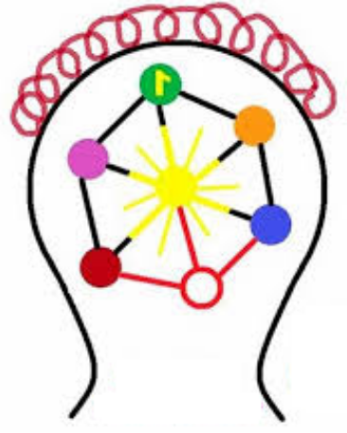
Methodology
RIT-ETC
Create a database-1
  Scan fingerprint using Scanner of voter
  Fingerprint extraction from the data of voter
  Different features of the voter fingerprint is compared
  Matching of the extracted data with the stored in the database
  Display the details of the voter
  Rejection of fake voter if he/she not existing in the database.
  Allow voter to vote

Slide 9
Methodology
RIT-ETC
Create a database-2
  Eliminate the details of the voter who has done voting or otherwise put this on cloud and if he/she came for voting display that you done your voting.

Slide 10
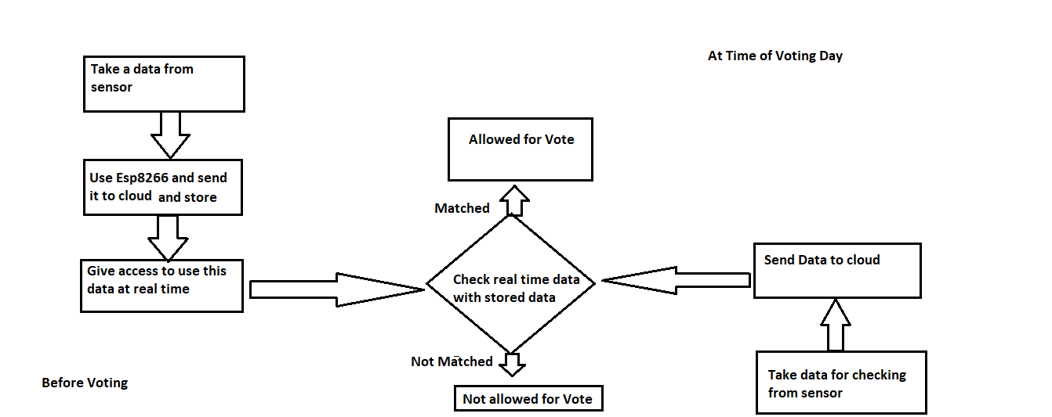
Flowchart of Database
RIT-ETC

Slide 11
Project Applications
RIT-ETC
Can prevent card counters, etc. from entering casinos
Can identify terrorists, criminals, etc.
Can find missing children.
Prevents voter fraud.

Slide 12

Hw/Sw Requirements and Future Scope:
RIT-ETC
Hw/Sw Requirements :
SQL Database.
Fingerprint Scanner.
Raspberry Pi
Firebase
Future Scope:
Detect the fake voters
Any bill payment by one touch.
It is easiest way to implement a system of authentication for multiple applications.

Slide 13

Concluding remarks
RIT-ETC
By using this system we will get cost efficient .
Fake voters can not allowed for voting .
Can prevent card counters, etc. from entering casinos.
It is more digitized system of authentication

Slide 14
REFERENCES
RIT-ETC
https://en.wikipedia.org/wiki/Issue_voting
Cho, Sungdai; Endersby, James W. (March 2003). "Issues, the spatial theory of voting, and British general elections: a comparison of proximity and directional models". Public Choice. 114 (3): 275–293. doi:10.1023/A:1022616323373. JSTOR 30025956. S2CID 152635457.
Converse, Philip E. (January 2006). "The nature of belief systems in mass publics (1964)". Critical Review. 18 (1–3): 1–74. doi:10.1080/08913810608443650. S2CID 140857433
Rabinowitz, George; Jacoby, William; Prothro, James W. (February 1982). "Salience as a factor in the impact of issues on candidate evaluation". Journal of Politics. 44 (1): 41–63.
.

Slide 15


